Slide 1
PSAS Launch Tower Upgrade
REVIEW PRESENTATION

Slide 2
Launch Tower Goals
Any Linux computer put as controller.
I/O management through USB external to control computer.
Acquisition of environmental conditions (wind, temperature, humidity)
Smaller tower box (reduction of 50% weight)
Visual indication of system health @ launch tower
Visual ground control software
Provide future capabilities
  Trigger video acquisition of takeoff.
  Addition of more sensors

Slide 3
Old vs. New System
Unreliable wireless
System weight
System size
Ign. battery weight
x86 and PIC boards lost in time
Questionable reliability
New wireless card
Lighter
Smaller
LIPO Launch battery
New COTS system
Designed to be reliable

Slide 4
How Reach Goals
Smaller Computer
  Beagleboard
Data Acquisition
  Phidgets
System Health
  Power Interface Board
  Ignition Board

Slide 5
System Block Diagram
Rocket Ready
ROCKET
Rocket Umbilical
V_{UMBILICAL (24v)}
Ignition Board
V_{IGNITION}
IGNITION BATT
~14.8v (3.7v * 4)
4S1P
Charger
CHARGER
V_{UMBILICAL (24v)}
RS232
Phidget Relay
usb
WiFi
usb
Rocket Ready
Phidget Interface
usb
BeagleBoard
V_{LTC}
V_{SYSTEM (5v)}
V_{SYSTEM (5v)}
Horns/Lights
Power Interface Board
(common ground)
V_{LTC}
V_{UMBILLICAL (24v)}
PV
Charger
V_{UMBILLICAL (24v)}
V_{SYSTEM (5v)}
V_{BATT}
V_{LTC}
V_{LTC}
LTC BATT
~12.6v
24v DC/DC
Converter
5v DC/DC
Converter

Slide 6
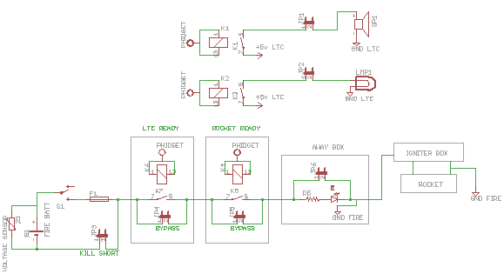
IGNITION PATH & FEATURES
Siren and light need to pull power from system battery so they don’t drain ignition battery.
Pull jumpers to disable feature.
Ability to bypass needing rocket ready or computer signal. Good for testing or bypassing equipment failure.

Slide 7
Power Interface Board
PROS
  Provide single point to view system health with LED indicators
  Provide on-board conversion of voltage
  Provide common ground point
CONS
  Star topology for power

Slide 8
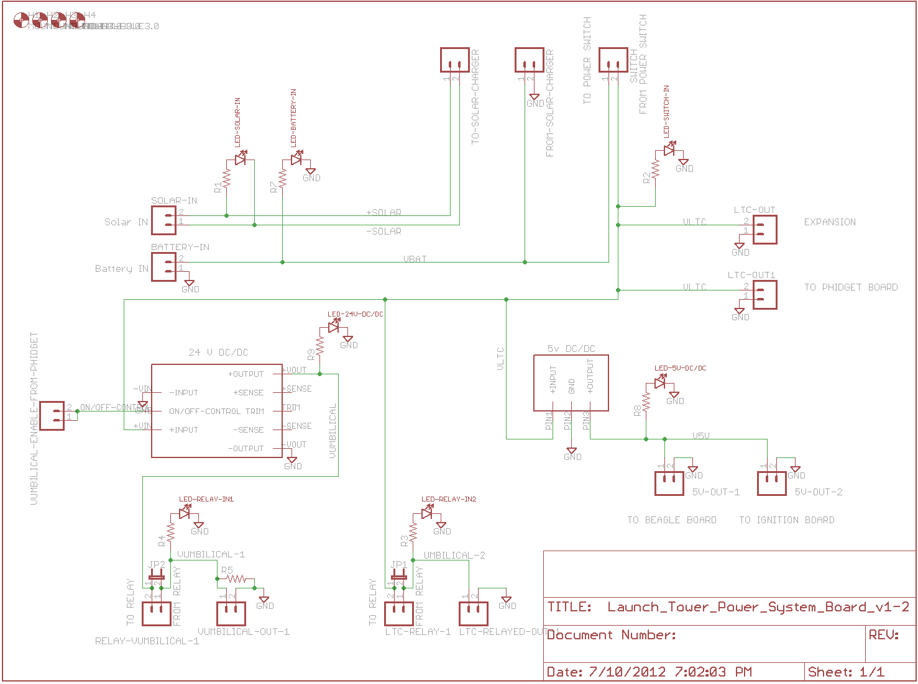
Power Interface Board

Slide 9
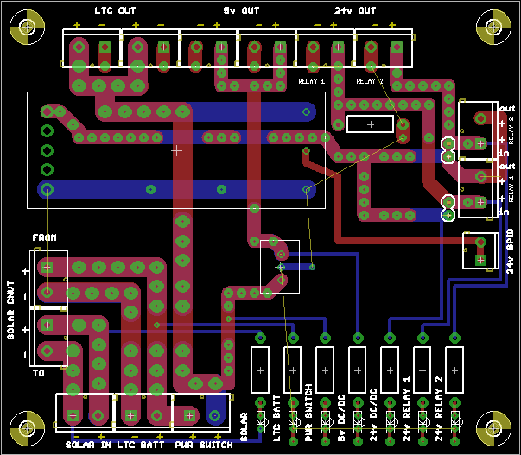
Power Interface Board
Ground plane on both sides of board
Traces on both sides are “stitched” together
5v DC/DC could be mounted horizontally w/ 90* headers

Slide 10
Ignition Board
Combines the capability of rocket-ready with all LIPO battery functions.
PROS
  LIPO Battery
  Charging functions handled on board and controlled via Phidget relays
  Timing circuit designed for drop-in change of resistor and capacitor
  Has bypass jumpers for testing and bypassing fault on launch day (unsafe)
CONS
  Not digital (but its cool to go analog sometimes)

Slide 11
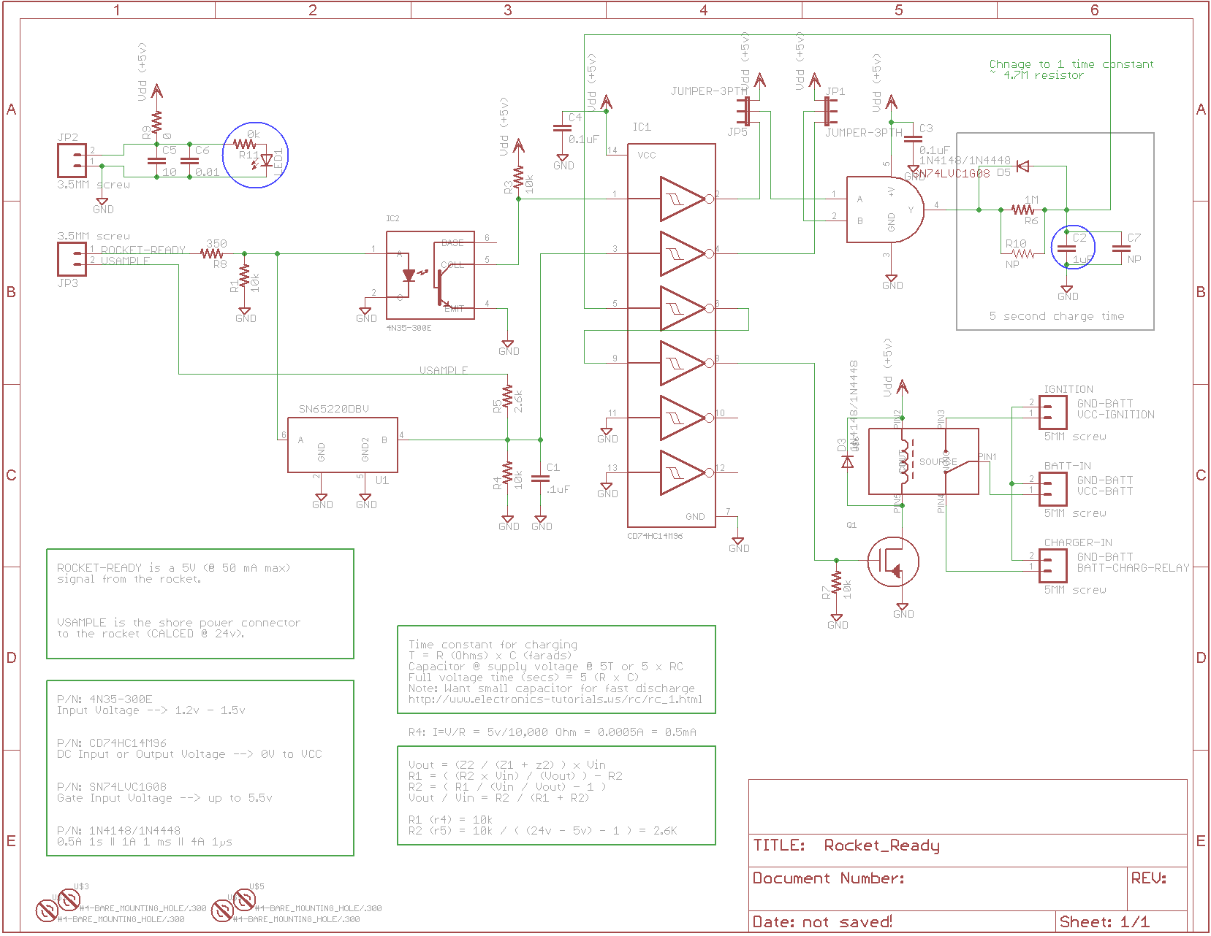
Ignition Board

Slide 12
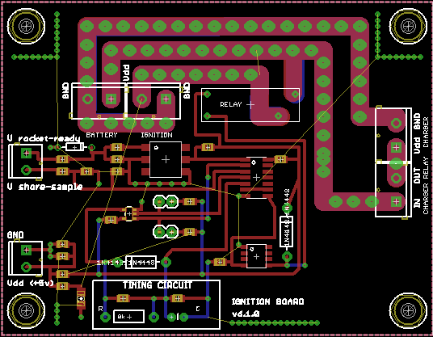
Ignition Board
Ground plane on both sides of board
Traces on both sides are “stitched” together

Slide 13
Timeline
Order Parts 1 week
Manufacture Boards 1 week
Assembly & Test 2 weeks
  Possible initial rocket access tests
Mid-August mount to launch tower and mate with rocket for full testing.

Slide 14


